Slide 1
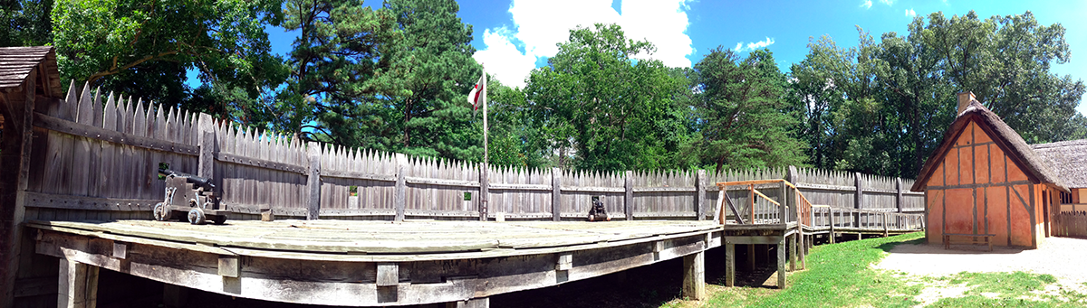
BRITISH COLONIES AND INDIAN NATIONS
History 180 - 2

Slide 2
RECAP:
Last time we examined Ancient (pre-Columbian America), exploring ways in which Indian civilizations underwent change and transformed their environment. We also looked at internal factors that led European countries to explore and then colonize the Americas.
This time: We turn our attention to early English settlements along the Eastern Seaboard.

Slide 3
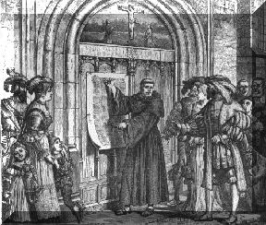
RECAP: THE PROTESTANT REFORMATION
What did the Protestant Reformation
do the European
states just as they began their voyages
of discovery?

Slide 4
ESTABLISHING PERMANENT SETTLEMENTS
First permanent settlements organized under King James I (r. 1603-1625)
English population growing with access to new food products
Peasants cut off from public lands by growing “enclosure movement”
Debtors and criminals escaping English justice system
Religious dissenters, (though most go to New England not Chesapeake)

Slide 5
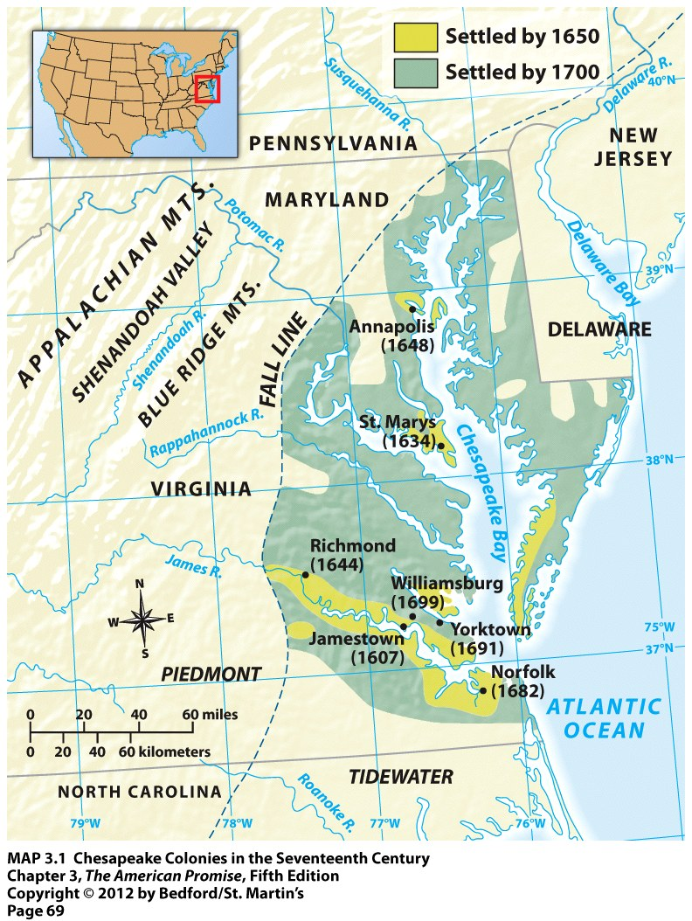

Slide 6
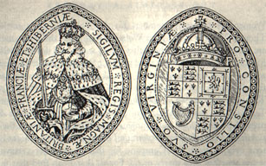
THE VIRGINIA COMPANY
The Virginia Company of London was a joint-stock company.
Sent 144 colonists to Jamestown, who arrived on April 26, 1607
High percentage of “gallants”

Slide 7
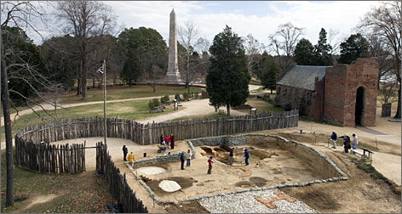
HISTORIC JAMESTOWN

Slide 8
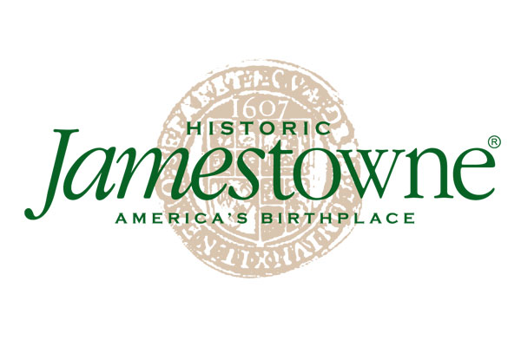
HOW WE REFER TO JAMESTOWN

Slide 9
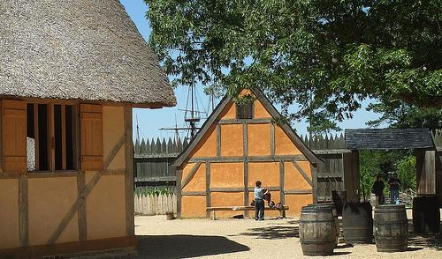
HOW WE REFER TO IT: 2
http://www.hotelclub.com/blog/the-most-historical-cities-in-america/

Slide 10
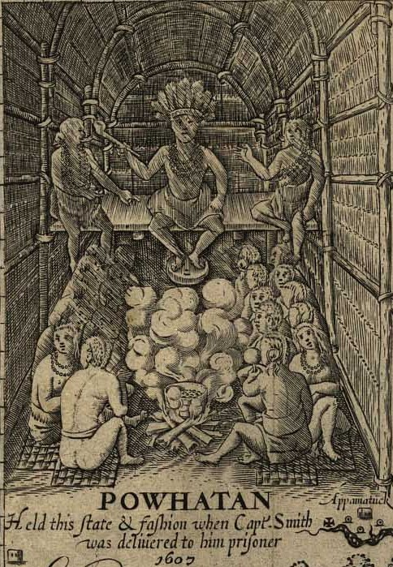
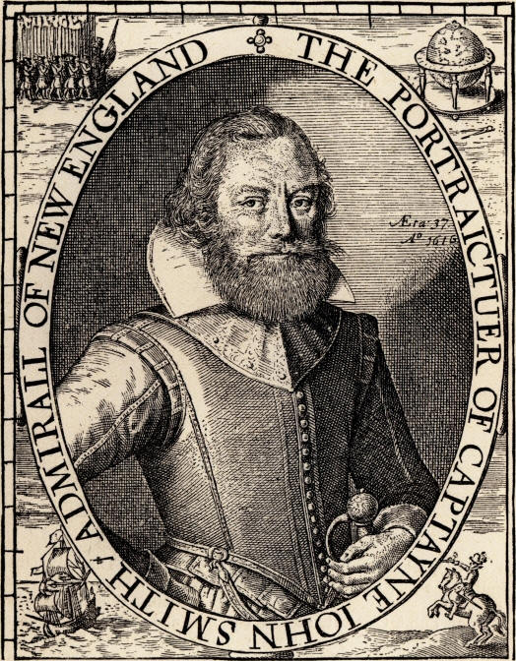
POWHATAN AND JOHN SMITH

Slide 11
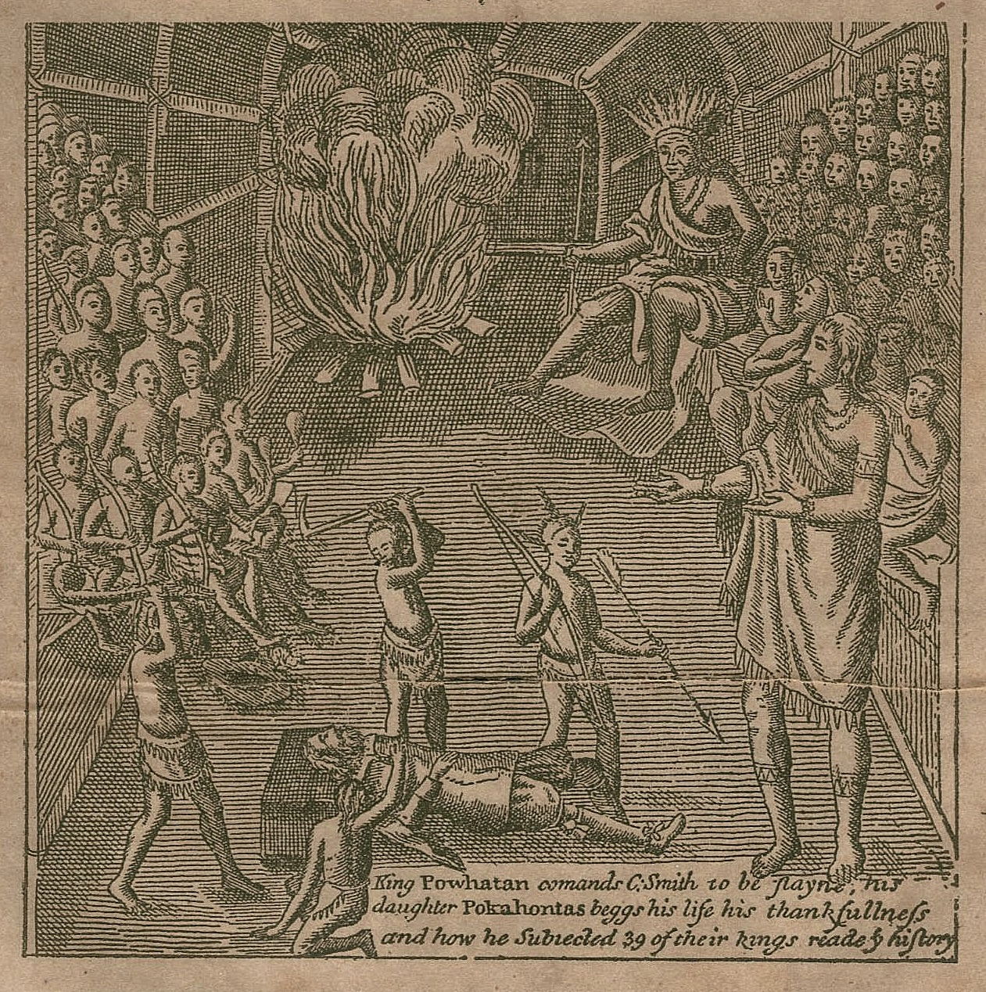
https://www.youtube.com/watch?v=m5UcpNPLTD
k

Slide 12
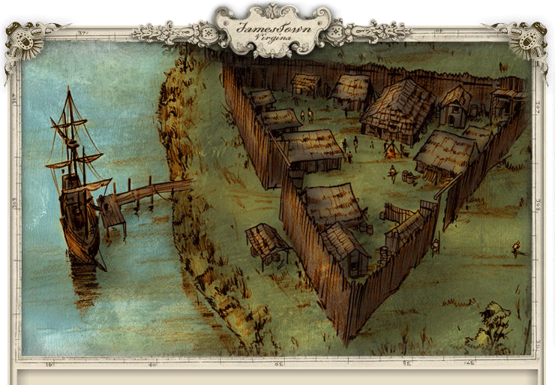
EARLY JAMESTOWN

Slide 13
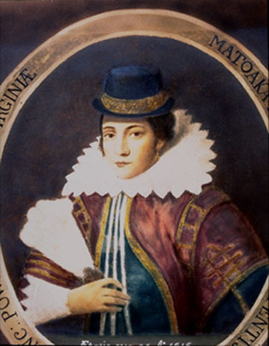
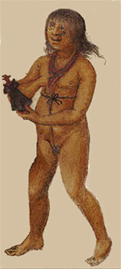
POCAHONTAS IN LONDON
Watercolor of Indian girl by
Englishman John White

Slide 14
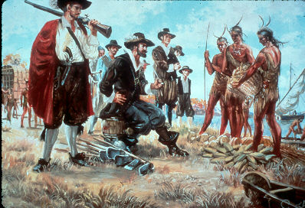
TRADE WITH THE POWHATAN CONFEDERACY
To Indians:
steel knives
axes
steel pots
To English Settlers:
corn
corn
more corn

Slide 15
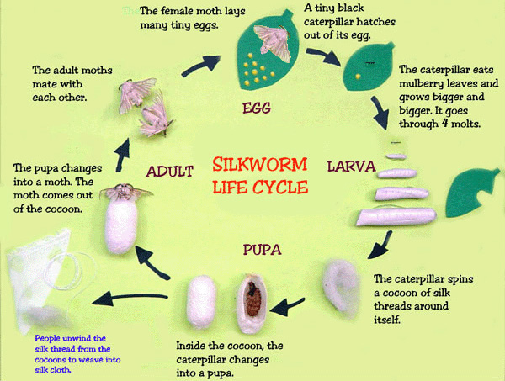
SILK

Slide 16
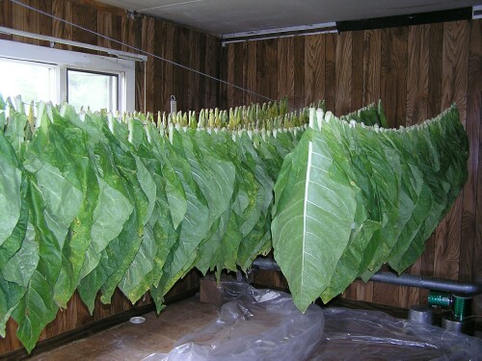
BUT BY FAR THE MOST IMPORTANT CASH CROP WAS TOBACCO

Slide 17
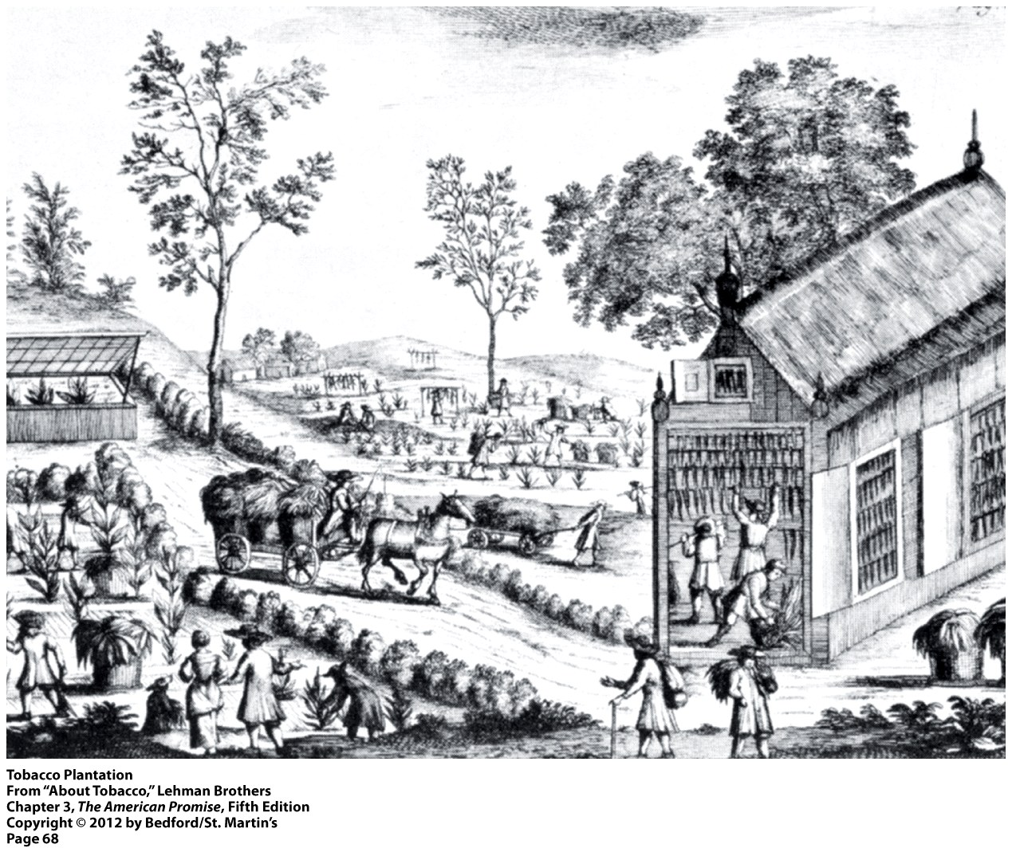

Slide 18
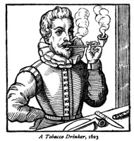
TOBACCO SMOKING BECOMES VERY POPULAR IN EUROPE

Slide 19
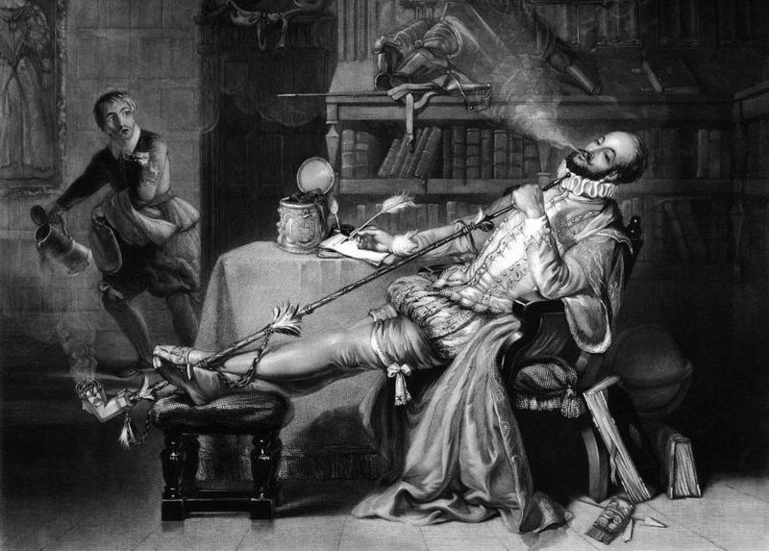
SIR WALTER RALEIGH, BECOMES FIRST TO BRING TOBACCO PIPE TO ENGLAND

Slide 20
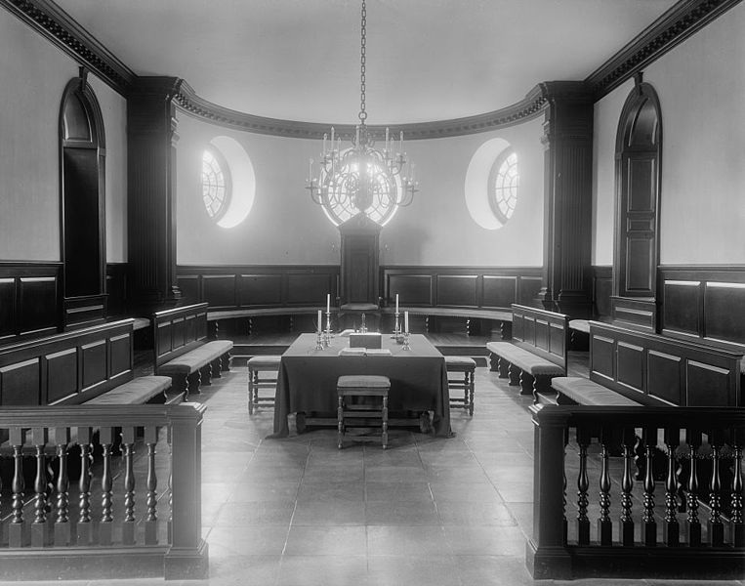
HOUSE OF BURGESSES
Reconstructed House of Burgesses, located in Colonial Williamsburg

Slide 21
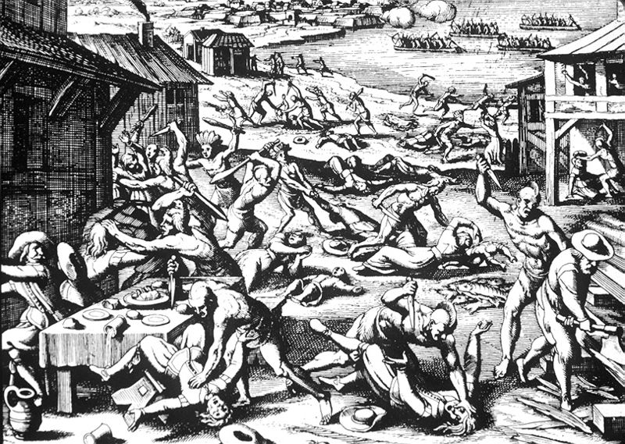
OPECHANCANOUGH’S RAID
The end of cooperation with the Powhatan confederacy.

Slide 22
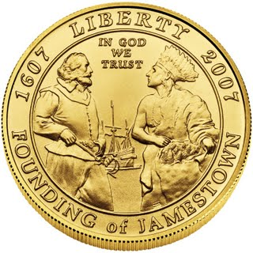
The Far East has its Mecca, Palestine its Jerusalem, France its Lourdes, and Italy its Loretto, but America's only shrines are her altars of patriotism - the first and most potent being Jamestown; the sire of Virginia, and Virginia the mother of this great Republic.
-- from a 1907 Virginia guidebook
https://www.youtube.com/watch?v=O_8J4XEeRgM

Slide 23
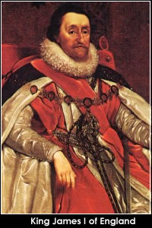
ROYAL COLONY
In 1624, King James I revoked the charter of the Virginia Company, making Virginia a royal colony citing mismanagement by the company.

Slide 24
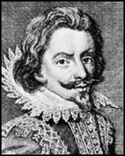
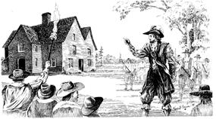
NATHANIEL BACON’S REBELLION
Bacon was a Cambridge-educated planter, cousin of Virginia governor William Berkeley
Led a populist uprising of the disenfranchised in 1676 before dying of swamp fever.

Slide 25
FILM EXCERPT: AFRICANS IN THE AMERICAS: PART 1: THE TERRIBLE TRANSFORMATION
Main ideas to watch for:
What evidence exists that the creation of an enslaved labor force in which “slave” meant “black” and “black” meant “slave” was not inevitable?
Why did this terrible transformation ultimately take place?
Terms to watch for:
Jamestown
Anthony Johnson
John Punch
“Angola” Plantation
Oulaudah Equiano
Royal African Company
Elmina Castle
factories
The Middle Passage
Notes:
We will watch beginning to 00:51:00 (skip the credits), to the point when Captain John Barbeau discusses captives jumping overboard to escape their captors.

Slide 26
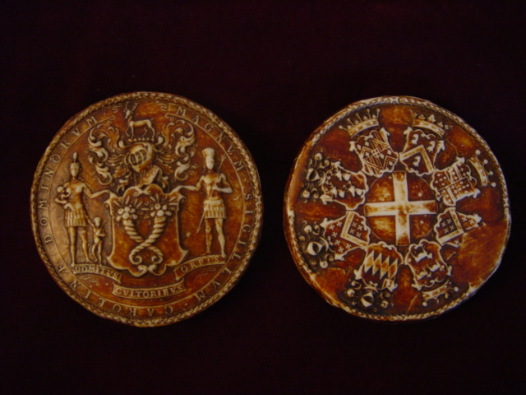
CAROLINA – A PROPRIETARY COLONY
Founded in 1663
Fundamental Constitution of 1667
“Carolina in ye west Indies”
Seal of the eight proprietors of Carolina

Slide 27
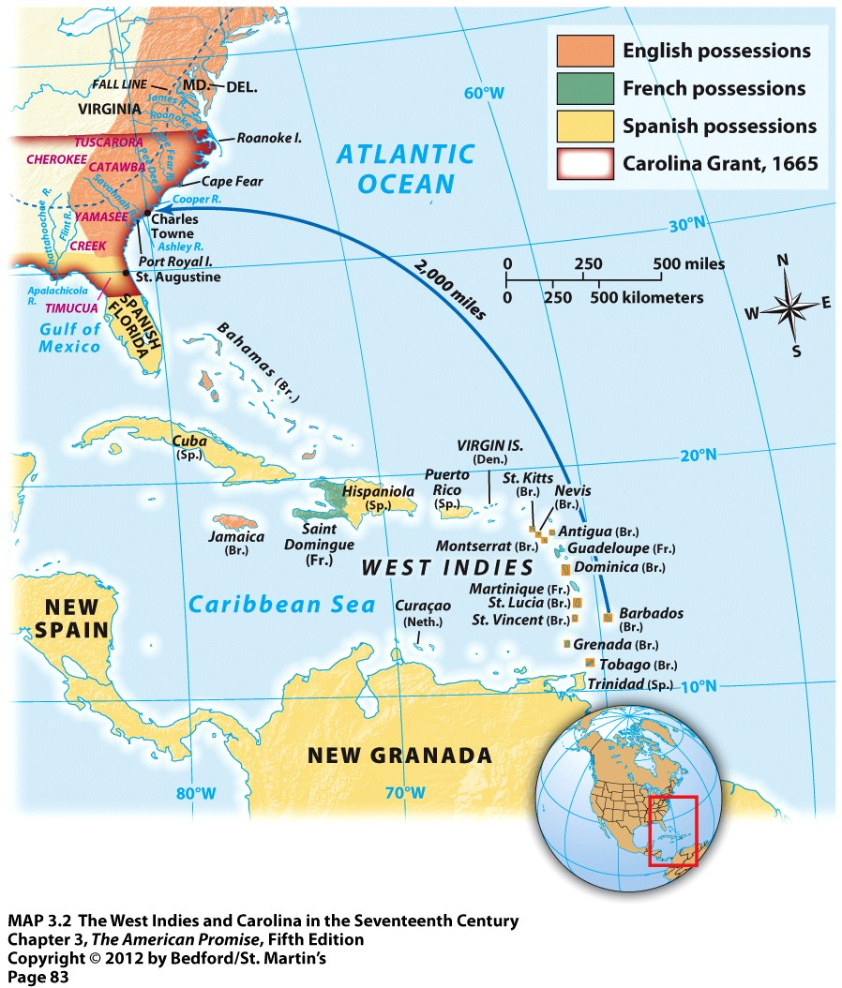
“THE COLONY OF A COLONY”
←

Slide 28
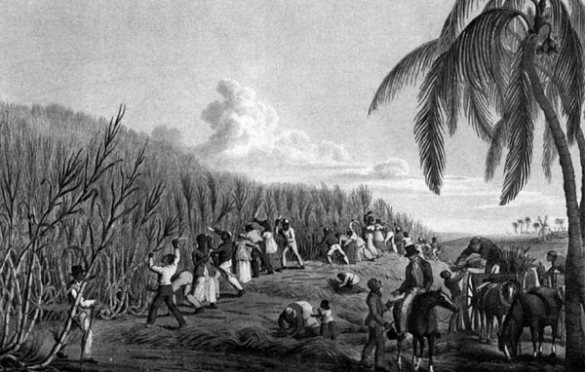
SUGAR CANE IN BARBADOS

Slide 29
CLIMATE IN SOUTH CAROLINA
“In the spring, a paradise, in the summer a hell, in the autumn a hospital”
Settlers suffer extensively from malaria and yellow fever

Slide 30
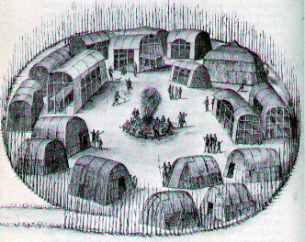
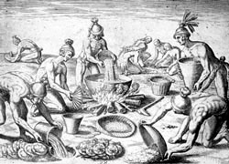
“THINNING THE INDIANS”

Slide 31
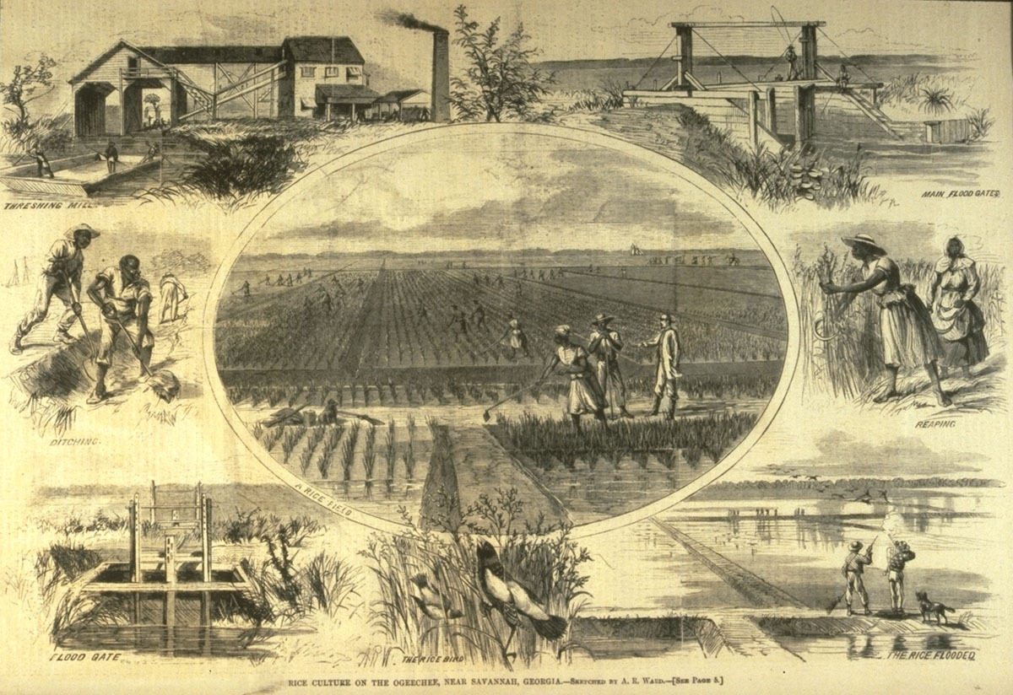

Slide 32
SLAVERY IN THE SOUTH
Transition to slave labor system
20,000 slaves in 1700
400,000 slaves in 1770
Two zones
Upper South – Virginia and North Carolina grow tobacco
Lower South – South Carolina, Georgia, grow rice and indigo

Slide 33
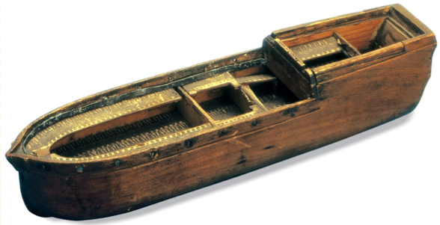
SLAVE TRADE AND NATURAL INCREASE
15% of enslaved Africans did not survive the middle passage
Slaves often sold to different owners to limit rebellions
By 1740, majority of the slave population in the colonies was born in the colonies.

Slide 34
NEXT TIME:
Foundations of an American Identity
This week we will examine the settlement of Puritans in New England during the 17th century, and then turn our attention to the transformations that took place in England’s colonies in North America during the 18th century.
Required readings: Roark, et. al… The American Promise, chapters 4 (all) and chapter 5 (111-125)

Slide 35
REVIEW: BROAD QUESTIONS
What evidences exists that the growth of slavery was not inevitable in the British colonies in the Americas?
What types of relationships did Native Americans have with British colonists? Was warfare the rule, or the exception?

Slide 36
REVIEW TERMS
John Smith
Powhatan
Pocahontas
Virginia Company of London
joint-stock companies
House of Burgesses
indentured servants
tobacco in Virginia
slavery in Virginia
Anthony Johnson
Bacon’s Rebellion
Olaudah Equiano
Middle Passage
Barbados
rice in South Carolina

